Slide 1


Slide 2

MCF-
Catarrhal mucopurulent nasal discharges,
muzzle encrustation,
stomatitis and erosion of papillae,
Stringing/ropy salivation,

Slide 3
lacrimation-purulent,
photophobia,
Conjunctivitis,
hypopyon ,
blindness-corneal opacity(limbus to centre),
lungs not much affected but upper respiratory tract
lymphadenopathy

Slide 4

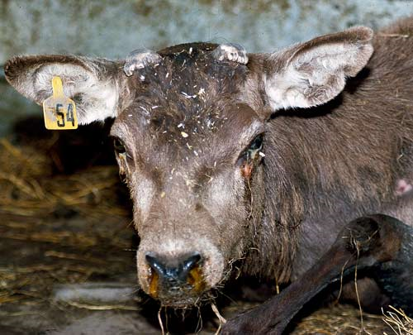

Slide 5

high fever of up to 42ºC
Frothy discharge through the nose,
petechiae hemorrhages,
salivation- frothy,
lacrimation-watery,
corneal clouding centre to limbus,
Soft moist cough,
lower respiratory system affected-emphysema, edema, harsh lung sounds
Diarrhoea (terminal)
Lymphadenopathy
Piroplasms in RBC

Slide 6
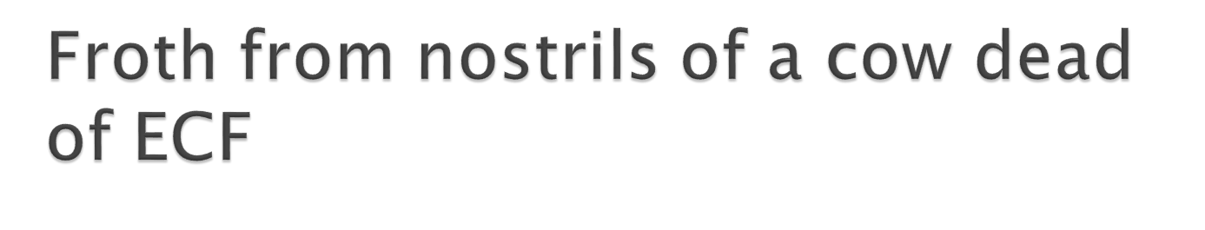
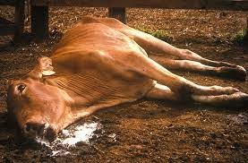

Slide 7

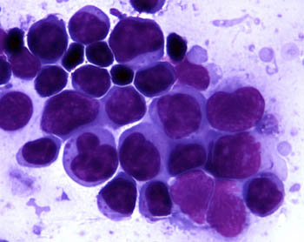

Slide 8

Serus nasal discharge,
nasal mucosa inflamed and ulcerative (red nose),
muzzle is inflamed,
salivation is frothy,
excessive lacrimation,
catarrhal conjunctivitis and keratitis leading to staphyloma,
Dry cough,

Slide 9

dyspnoea,
genitalia- pustular vulvovaginitis leading to abortion,
calves- nervous signs.
Rinderpest –
Bloody diarhoea,
bloody nasal discharge (epistaxis),
bloody salivation,
deep ulcers in the mouth,
High mortality and death is fast.

Slide 10

High fever just like in ECF
Mucopurulent nasal discharge,
rhinitis,
cough,
hyperpnoea,
pleuritic rubs.
No lymphadenopathy

Slide 11

Mucopurulent nasal discharge,
cough,
severe respiratory distress- open mouth breathing,
extended neck,
abducted elbows,
exercise intolerance and quick death.
Lung- dry painful pleuritic rubs

Slide 12

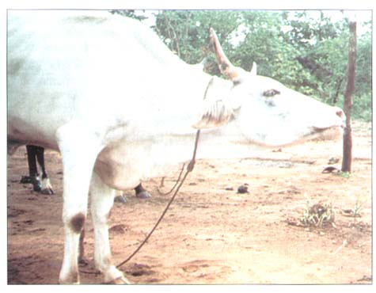

Slide 13

Actinobacillosis – granulomatous swellings on soft tissue around head & neck region
Actinomycosis – granulomatous swelling on boney tissue of the head
Nasal obstruction
pharyngitis
necrotic laryngitis,
calf diptheriae

Slide 14

High altitude disease- brisket edema DDX- TRP- do differential cell count. Leucocytosis in TRP not in brisket,
Bloat-abdominal distention-fast onset,
vagal indigestion- bloat slowly and then disappear.

Slide 15

1.Parainfluenza-3-Upper respiratory problem
2.Hydatidosis- take blood and examine- eosinophilia
3.Gangrenous pneumonia-Diagnosed by history –animal drenched or chocked, milk fever complication, anaesthesia, pharyngitis or nervous signs e.g. botulism
5.Enzootic viral pneumonia- of calves, housed calves,

Slide 16

6.Pulmonary neoplasm- difficult to diagnose. Consolidation, Biopsy may help; chest x-ray is only useful in small/young animals
8.Diaphragmatic hernia-Animal goes into shock- do thoraco-centesis- get abdominal fluids from the chest cavity

Slide 17

Two types of snoring. 1. True snoring- due to pharyngeal obstruction- noise is guttural/ larynx and pharynx and air is not obstructed.
Common causes
1.Enlargement of retropharyngeal lymph nodes caused by diseases e.g. TB, Actinobacillosis, bovine viral leucosis, strangles in horses

Slide 18

2.Chronic obstructive lesions of the pharynx- fibrous or mucoid polyps or pharyngeal cyst especially in horses.
3.Pharyngitis- clinically manifested as coughing,
painful swallowing and lack of appetite,
regurgitation through nostrils and drooling of saliva in severe cases.
It is caused by physical injury e.g. ingestion of irritants substances, foreign body or stomach tube.

Slide 19

4.Infectious agent-
oral necrobacillosis,
IBR,
Pharyngeal phlegmon or intermandibular cellulitis,
anthrax especially in horses and pigs.

Slide 20

Occurs when there is obstruction or narrowing of nasal passages.
Most common type of snoring, can be heard from a distance.
Characterised by
nasal discharge,
partial or complete obstruction to air flow,
mouth breathing may be evident.

Slide 21

Most common causes
1.Allergic rhinitis
2.Mucosa polyps – in nasal passages
3. Nodular thickening of nasal mucosa

Slide 22

Equine-
1. Strangles- affect lymphnodes, high temperature, snoring, purulent nasal discharge, cough
2. Heaves-allergic respiratory disease of horses characterized by chronic cough, nasal discharge, and respiratory difficulty.
Heaves in horses is most similar to asthma in humans.

Slide 23
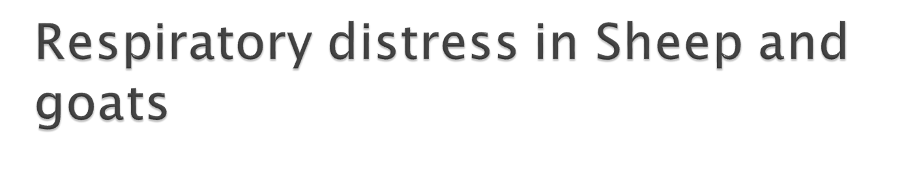
1.CCPP
2.Pasteurellosis
3.Lungworm
4. Jaagsiekte (Sheep)-pulmonary adenomatosis-many sheep are sick, bubbling sound from afar, chronic –loss of condition.
5. Sheep and goat pox disease

Slide 24

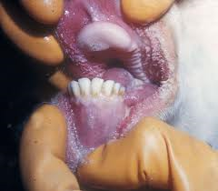
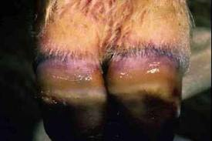
6. Blue tongue

Slide 25
